Slide 1


International University
MICRO-PROCESSING SYSTEM
Lecture 3C:
AVR Assembly to Hex Compiler Tutorial
Vo Minh Thanh, M.Eng
School Of Electrical Engineering

Slide 2
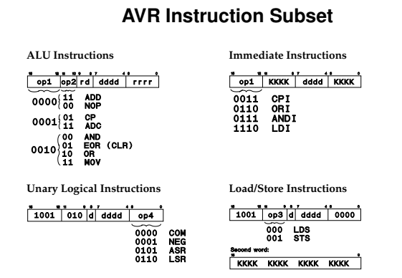

Slide 3
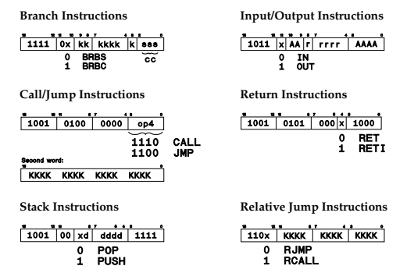

Slide 4
AVR Assembly Example code
ldi r16, 0x20
out DDRB, r16 // set PB5 to output
loop:
out PINB, r16 // toggle PB5
ldi r17, 0xff
wait:
dec r17
brne wait
rjmp loop

Slide 5
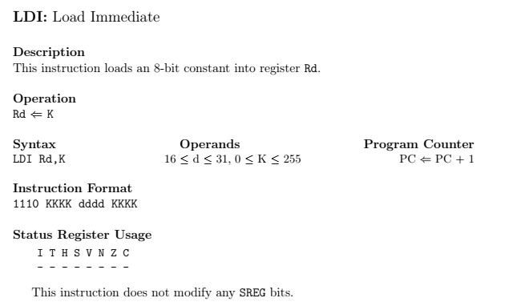
Instructrion complile
asm bin hex
ldi r16, 0x20 1110 0010 0000 0000 E200
ldi r17, 0xff 1110 1111 0001 1111 Ef1f ldi r20, 0x7A 1110 0111 0100 1010 E74A
ldi r29, 150 1110 1001 1101 0110 E9D6

Slide 6
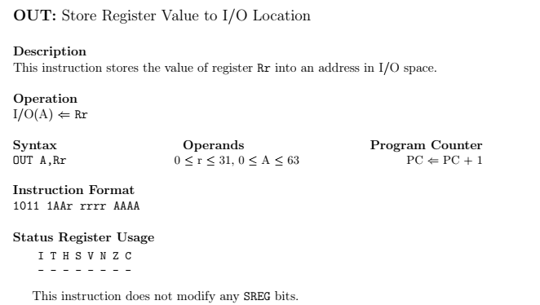
Instructrion complile
A CHI CAN 6 BIT DE BIEU DIEN, DICH BEN PHAI TRUOC XONG ROI MOI TOI BEN TRAI r CAN DEN 5 BIT DE BIEU DIEN, ….
asm bin hex
out 0x37, r16 1011 1
out 0x24, r25

Slide 7
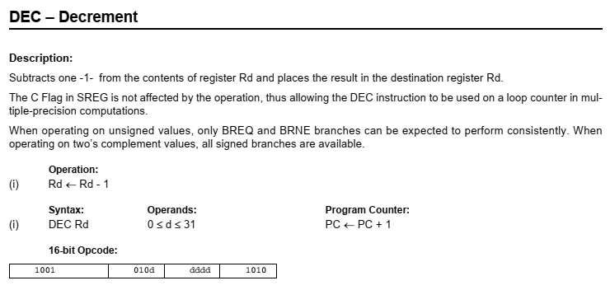
Instructrion complile
asm bin hex
dec r17 1001 0101 0001 1010 951a

Slide 8
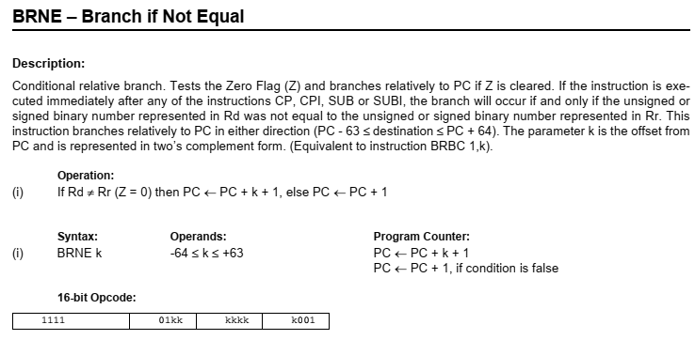
Instructrion complile
REMEMBER VONG TRON SO HOC
asm bin hex
brne -2 1111 0011 1111 0001 f7f1

Slide 9
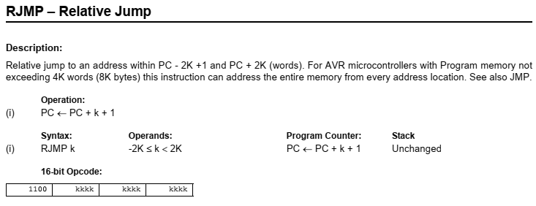
Instructrion complile
Nhay 4 + 1 lenh
asm bin hex
rjmp -5 1100 1111 1111 1011 cffb

Slide 10
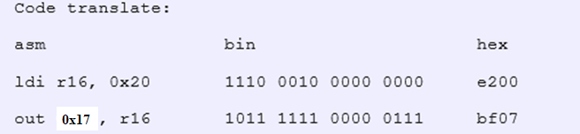

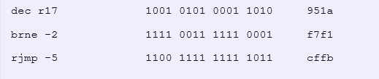
AVR Assembly complile to Hex
ldi r16, 0x20
out DDRB, r16
loop:
out PINB, r16
ldi r17, 0xff
wait:
dec r17
brne wait
rjmp loop

Slide 11
AVR Assembly complile to Hex
write a hexfile
For flashing, the program needs to be in the intel HEX format.
:[Data Size] [Start Address] [Record Type] [Data] [Checksum]
which gives:
: 0E00000000E27BF06BBF1FEF1A95F1F7FBC F1E

Slide 12
AVR Assembly complile to Hex
Exercise 1: Convert Following AVR Assembly to Binary code then machine hexa code:
.include "m32def.inc"
.org 0
rjmp main
main:
ldi r16, 0x20
out DDRB, r16
sbi PORTB, 6
loop_main:
sbis PINB, 6
rjmp button_led
cbi PORTB, 5
rjmp loop_main
button_led:
sbi PORTB, 5
rjmp loop_main

Slide 13
AVR Assembly complile to Hex
Exercise 2: Convert Following AVR Assembly to Binary code then machine hexa code:
LDI R22, 0xFF
OUT DDRB, R22
OUT DDRD, R22
LDI R24,0x00
OUT DDRC,R24
LDI R20,0xB5
loop: IN R18, PINC
OUT PORTB, R18
CPI R18,0xAA
BREQ Check
DEC R20
rjmp loop
Check: LDI R25,0x55
OUT PORTB,R25
rjmp loop

